Slide 2
Sea
Land
Semaphore
Glenelg
Brighton
Predominant wind direction
(South Easterly)

Slide 3
Sea
Land
Direction of sand transported by wind and waves
Backwash
Swash
Predominant wind direction
Predominant wave direction

Slide 4
Sea
Land
Semaphore
Direction of sand transported by wind and waves…. called Longshore Drift
Glenelg
Brighton
Predominant wind direction
(South Easterly)

Slide 5
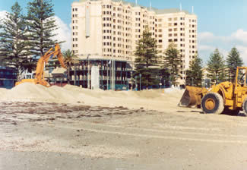
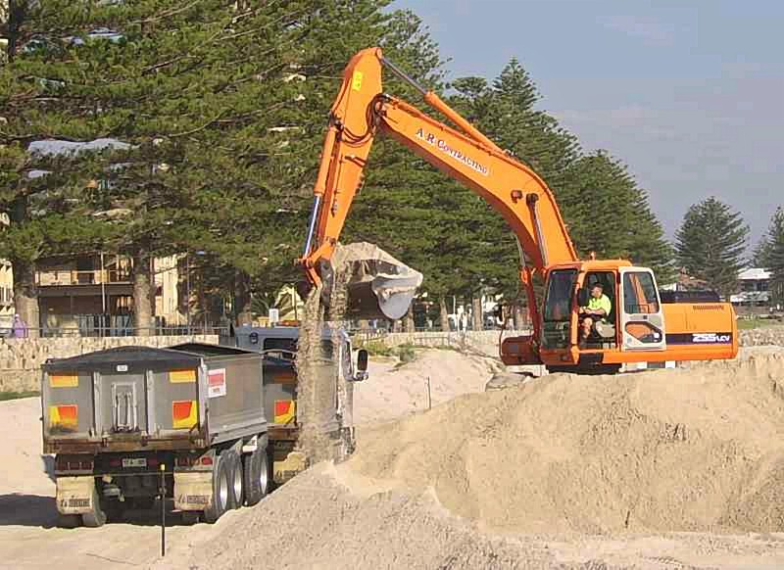
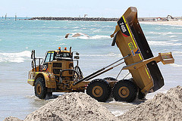

Slide 6
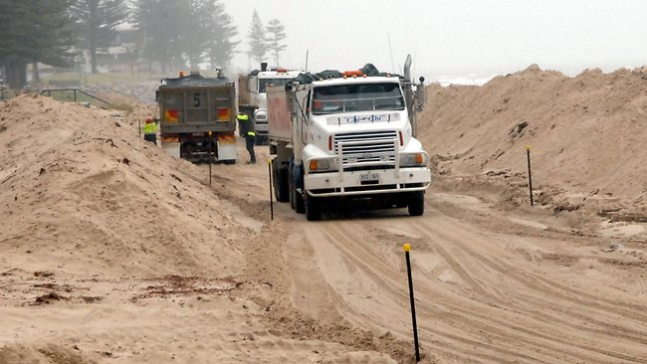
$10m bill to truck sand for our beaches
April 11, 2011

Slide 7
The State Government is close to starting construction of a $23 million pipeline that will limit the need to truck sand.
Figures provided to Parliament by Environment and Conservation Minister Paul Caica show 1.73 million cubic metres and sand have been moved at a cost of $10.3 million since the 2001-02 financial year.
The sand is shifted between Adelaide's western and northern beaches, including Glenelg, West Beach and Semaphore, to repair erosion damage.
The Government is in the final stages of tendering to build a 9km pipeline to pump and discharge sand along the busiest sections of the coast. It follows the abandoning of plans for a 22km pipeline due to the high cost. Trucking will continue on sections the Government designates "less busy".
The Liberal MP for the Glenelg-based seat of Morphett, Duncan McFetridge, said the full pipeline should be built to avoid substantial long-term running costs.

Slide 8
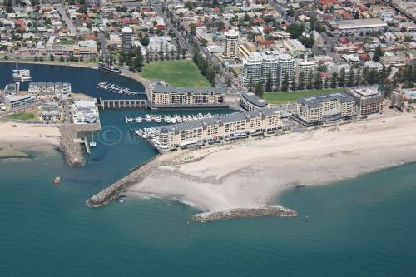
Groyne built to stop the northward moving sand from blocking the entrance to the multimillion Holdfast Shores Marina complex

Slide 9
A dredging boat removes sand that has come around the groyne and pumps it away from the mouth of the marina.

Slide 10
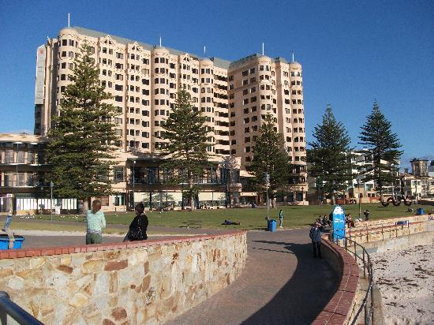
Sea Wall: Solid wall built to prevent the ocean from damaging infrastructure during storms.

Slide 11
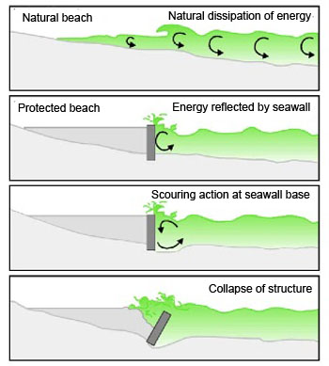

Slide 15
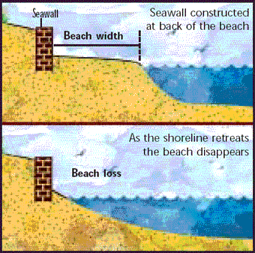

Slide 16
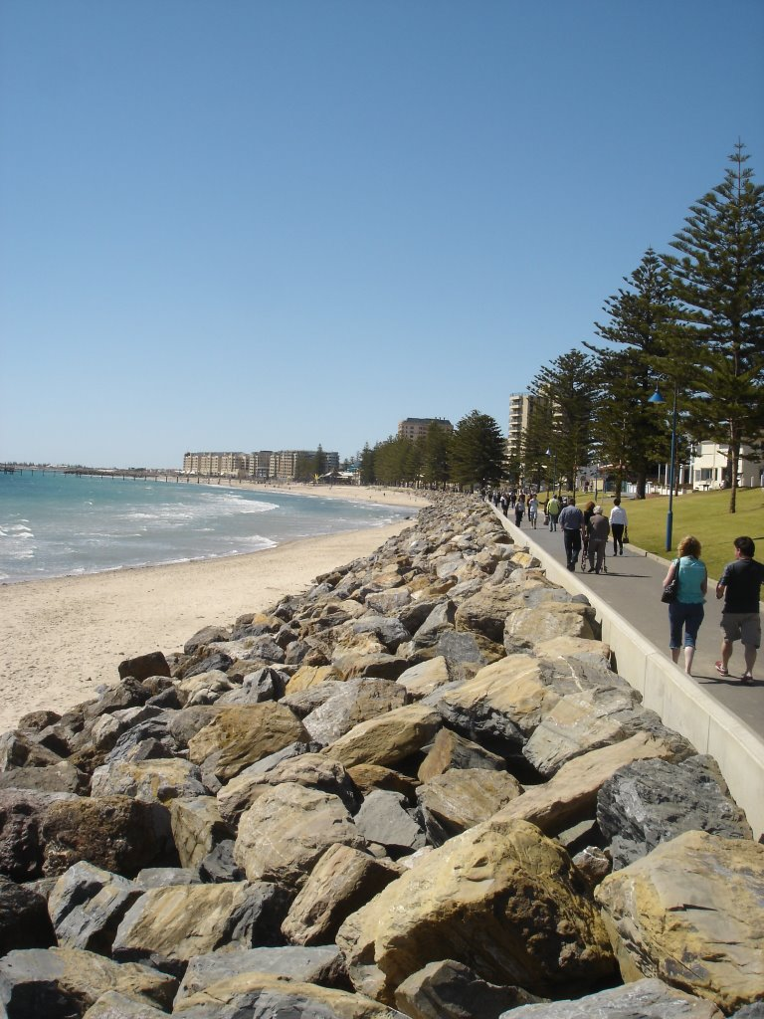
Rip Rap: Irregular shaped, randomly dumped large rocks absorb wave energy and prevent storm damage.

Slide 17
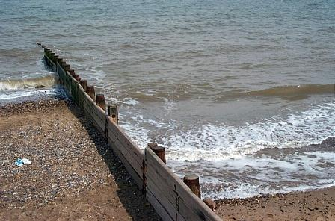
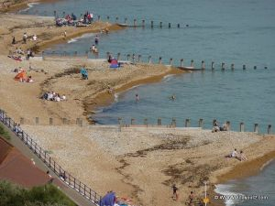
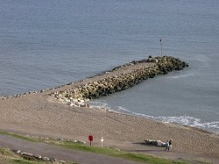
Groyne: A short barrier to intercept the movement of sand through Longshore Drift.

Slide 18
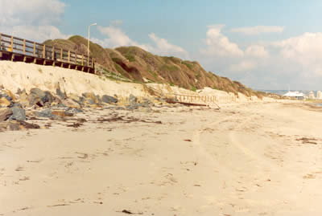
Dune management: Over development at West Beach caused serious erosion to occur.

